Slide 1
Sustainability Capstone:
Decarbonising Travel
Accelerating Net Zero Through Process Intelligence and Data-Driven Decision Making
Speaker name: Deneb Kumar Jena
Institute: GGSIP University, Delhi
Branch & Year of Study: 2008
Email ID: deneb.jena@gmail.com

Slide 2
Executive Summary – Towards Net Zero Business Travel by 2030
KPI | Value
Total Travel CO₂ Emissions | 178.1M kg CO₂e
Total Trips | 65,289
High-Carbon Trips | 16,326 (25%)
Average CO₂ per Trip | 2,728 kg CO₂e
Average CO₂ per Employee | 3209 kg CO₂e
Top 3 Insights
84% of travel emissions originate from flights, making aviation the primary decarbonization opportunity. Customer Visits (43%) and the Sales business unit (26%) are the largest contributors to travel emissions. 373 unique travel process variants identified; however, 87% of trips follow just 34 variants, indicating strong opportunities for workflow standardization.
Top 3 Recommendations
Restrict Business & First-Class Flight travel and promote rail alternatives on feasible European region. Adopt a Virtual-First Policy for internal meetings and introductory customer engagements to reduce unnecessary travel. Deploy AI-powered Carbon-Intelligence Travel App with carbon budgets, sustainable transport recommendations (carbon calculator), and real-time policy compliance using Celonis Process Mining.
Estimated Impact
Potential reduction of emissions (≈26% of the current travel footprint). | 46 million kg CO₂e
Estimated travel cost savings | $14 million
Notes:
Decarbonizing travel is critical to Celonis because business travel represents one of the company's largest operational carbon hotspots, making up roughly 47% of its Scope 3 footprint. Celonis has committed to reducing its Scope 3 business travel GHG emissions by 51.6% per Full-Time Equivalent (FTE) by FY2031. This cannot be achieved without identifying and removing the bottlenecks in employee business travel.
Celonis heavily markets sustainability tools like the Celonis Shipping Emissions Reduction App with Climatiq to its enterprise clients. So, Celonis must apply the same to its own process to reduce business travel inefficiencies and maintain market credibility.

Slide 3
Emissions Profile and Benchmarking
Celonis sustainability report indicates Scope 3 carbon emissions stems from employee business travel contributing 47.6% towards total emissions[1].
Industry Benchmark
Scope 3 emissions dominate the carbon footprint of SaaS and technology companies, often contributing to more than 90% of total emissions, making business travel an important decarbonization focus.[3][4]
Celonis travel emissions are consistent with SaaS companies where employee travel is one of the largest Scope 3 categories.
Celonis aligns with CDP benchmarks by targeting per-FTE intensity reductions (51.6%) to ensure the company lowers its environmental impact even as the business scales.[2]
Transport Mode Footprint
Flights account for approximately 84% of total travel emissions, making air travel the primary decarbonization opportunity. Rail and Ground Transit (≈ 15%) Trains and EVs account for 1.5% of emissions offering promising savings in costs and carbon emissions for net zero objective. Petrol/Diesel Cars account for 14% of emissions. Replacing them with EVs can have significant impact.
Regional Footprint
Regional analysis shows that Australia, Brazil, China are the largest departure emission sources. Route Analysis shows that Extra Long Haul & Long Haul Routes account for 75% of the Travel Emissions with Business & Economy Flights contributing 67% alone. All routes with a 100% High Carbon Rate (AU→DE, BR→JP, CN→TR) belong to the Long/Extra Long-Haul route & account for 25% of Emissions.
Notes:
[1] Celonis Sustainability Report 2024
[2] https://www.celonis.com/blog/science-based-targets-initiative-approves-celonis-near-term-emission-reduction-targets
[3] https://www.mckinsey.com/featured-insights/mckinsey-explainers/what-are-scope-1-2-and-3-emissions
[4] https://normative.io/insight/scope-3-emissions/

Slide 4
Hotspot Analysis
Business Unit Hotspots
Sales is the largest contributor, generating 47.1 million kg CO₂e (26.4%) of total travel emissions, primarily driven by extensive customer-facing travel. Marketing (14.8%) and Value Engineering (7.8%) are the next highest contributors, indicating that commercial and pre-sales functions account for the majority of travel-related emissions.
Travel Purpose Hotspots
Customer Visits account for 76.9 million kg CO₂e (43.2%), making them the single largest source of travel emissions. Conferences and Exhibitions contribute 35.4% of total emissions, highlighting external engagement activities as another significant carbon hotspot. The above 2 purposes are the highest-priority areas for emission reduction.
High-Impact Travel Routes
Australia → Germany (Extra Long Haul Route) is the largest carbon hotspot, generating 37.9 million kg CO₂e across 5,366 trips, with 100% classified as high-carbon. Australia → United States (Extra Long Haul Route) contributes 28.2 million kg CO₂e, making it the second-largest hotspot route despite a lower high-carbon rate (47%). Brazil → United States (15.5 million kg CO₂e) and Australia → Singapore (13.2 million kg CO₂e) also contribute substantially due to their high travel volumes. Although Brazil → Japan contributes a smaller total volume (5.5 million kg CO₂e), it records the highest average emissions per trip (7,693 kg CO₂e) with a 100% high-carbon rate, making it one of the least carbon-efficient routes. China → United States must not be ignored for its highest average emissions per trip (7,606 kg CO₂e).
Notes:
Most travel emissions come from a small number of business units, customer-facing activities, and long-haul international flights. Focusing on high-emission routes like Australia–Germany and Australia–United States, while improving travel policies for customer visits, would have the biggest impact on reducing carbon emissions.

Slide 5
Inefficiencies Identified
Process Inefficiencies
1. High Process Variation: 373 unique travel process variants were identified, indicating inconsistent travel execution. While the top 34 variants account for 87% of all trips, the remaining 339 variants have opportunities for workflow standardization. 2. Long Process Cycle Time: The average end-to-end travel lifecycle duration is 22.3 days. Also, the travel process records emissions after travel is completed, but employees currently receive no carbon guidance during planning. 3. Heavy Dependence on Air Travel: Aviation account for approximately 84% of total travel emissions. Departure and Return flights have same travel class (increases cost and emissions). 4. Emission Concentration: Few business units (Sales & Customer Visits) and Few Routes (AU → DE, AU → US, BR → US) contribute to highest share of carbon footprint. Small policy changes can have significant impact.
Data Inconsistencies
Route infeasibility: A number of train journeys and road journeys (e.g., China → India/USA/Aus/GB) appear operationally infeasible, suggesting synthetic routing assumptions within the dataset. In some routes the average netcosts of business class trips is lower than average netcosts of economy class trips. Employee travel continuity: Consecutive trips for the same employee (eg. M1009-M5146) sometimes originate from unrelated cities without recorded repositioning travel, indicating that employee location continuity is not explicitly modeled. Emission drivers: Hotel category impacts emissions than duration alone, creating a need to record hotel category to reduce emissions by prioritizing low-carbon hotels.
Notes:
The analysis indicates that emissions are driven more by process decisions (transport mode, travel purpose, and route selection) than by trip duration or accommodation. Standardizing travel workflows and optimizing high-emission air travel routes present the greatest opportunity to reduce both process variability and carbon emissions.

Slide 6
Low Carbon Strategic Recommendations (Quantified)
Top Recommendations | Data-backed Justification | Estimated CO₂ Reduction | Estimated Cost Savings
Restrict Business & First-Class Travel (VP level & above) | Business & First-Class flights are responsible for ≈80 million kg CO₂e (45% of total travel emissions). Reducing premium travel by 20% with stricter approval policies would significantly lower emissions. | ≈16M kg CO₂e | ≈$6.8M
Optimize High-Emission International Routes (AU→DE, AU→US, BR→US, AU→SG, BR→JP)[1] And Extra Long Haul, Long Haul and Short Haul Routes | These 5 routes alone generate ≈100M kg CO₂e (56% of total travel emissions). Conservative scenario[1] can reduce emissions by total 11%. | ≈11.6M kg CO₂e + ≈8M kg CO₂e | ≈$0.5M
Adopt a Virtual-First Policy for introductory client meetings and internal meetings | Customer Visits generate 76.9M kg CO₂e (43%) of total emissions. Replacing just 10% of these trips with virtual meetings would reduce unnecessary travel while maintaining client engagement. | ≈7.7M kg CO₂e | ≈$6M
Replace Return Flights with Rail on Feasible European Corridors (e.g., DE→FR, DE→NL, DE→IT, DE→ES and domestic Germany) | Rail-connected European routes currently generate ≈1.67M kg CO₂e from Business & First-Class flights alone. Replacing these flights with rail returns is a quick-win solution.[2] | ≈3.3M kg CO₂e | ≈$0.5M (No return airfare and airport-related costs)
Deploy AI-powered Carbon-Intelligence Travel app using Celonis | Integrate carbon budgets, approval workflows, low emission recommendations, carbon calculators and policy checks into the booking process to prevent high-carbon travel before it is booked. | Continuous long-term reduction | Reduced travel and administrative costs
Estimated Impact: 46 million kg CO₂e Savings & ≈ $14 million Cost Savings
Reduced dependence on premium flights & unnecessary travel. Improved policy compliance through AI and Process Mining.
Notes:
Variants like (Book Mode of Transportation, Flight Cancellation, Book Mode of Transportation, Book Lodging, Submit Travel Request, Travel Request Approved, Receive Confirmation, Take Departure Flight, Book Lodging, Take Return Flight, Submit Expense Request, Expense Request Approved, Expense Reimbursement) have high emission, high cost and longer TPT. Economy class flight can be opted for instead of business class in such case.
Celonis can use Process Mining to identify such variants that consistently exhibit high CO₂ emissions, higher costs, and longer throughput times. These variants should be prioritized for policy changes such as rail-first travel, virtual meetings, or approval restrictions.
[1] Optimizing through consolidating multiple client meetings into one trip, replacing some trips with virtual meetings, eliminating unnecessary travel, selecting lower-carbon airlines or direct flights, improving advance planning.
[2] Carbon and cost savings were estimated only the basis of replacing return flights with trains. Full replacement can double the savings.

Slide 7
Intelligent Net-Zero Travel
• Establish regional Solution centers.
• Real-time Process Mining to detect policy deviations.
Strategic Integration Roadmap
Optimize Travel Decisions
• Replace rail-feasible European flights with train.
• Optimize high-emission routes (AU→DE, AU→US, BR→US, AU→SG).
2029
2030
Continuous Monitoring
• Continuous carbon monitoring by department and employee.
• Integrate travel data with corporate ESG reporting.
2027
Build the Foundation
• Introduce Virtual-First Policy for internal meetings and introductory client engagements.
• Restrict Business & First-Class travel through approval workflows.
• Launch carbon-aware travel dashboard in Celonis.
2028
2026
Partner and Deploy
• Partner with airlines offering Sustainable Aviation Fuel (SAF).
• Deploy AI-powered Carbon-Intelligence Travel App for calculating trip emissions, recommendations, emission tracker and carbon budgets.

Slide 8
Other Recommendations
Establish regional pre-sales and remote support centers reduce long-haul travel and maintain customer responsiveness. Value engineers can be positioned near client location.
Talk to enterprise clients keen on reducing their carbon footprint. Virtual meetings and technical support can benefit both celonis and its clients in reducing their overall carbon footprint.
Business Class and First-Class Travel can be restricted to VP level or above.
Consolidate multiple meeting in a single trip, reduces cost and emissions significantly.
Set carbon budgets per employee and business units.
Educate employees on decarbonization. Implement an incentive program that recognizes employees who consistently reduce corporate travel costs and minimize carbon emissions.
Build AI-powered Carbon-Intelligence Travel App/Assistant that can calculate trip emissions, recommends rail over flights, checks weather disruptions, flags Business Class bookings, checks carbon budget, recommends nearby colleagues instead of flying another employee.
Partner with airlines offering bulk discounts, Sustainable Aviation Fuel (SAF) and low-emission routes for unavoidable long-haul travel.
Resolve data level inconsistencies like transport mode infeasibility, missing record on hotel category, missing employee travel sequence.
Invest in inhouse fleet of electric vehicles for local and short haul routes.

Slide 9
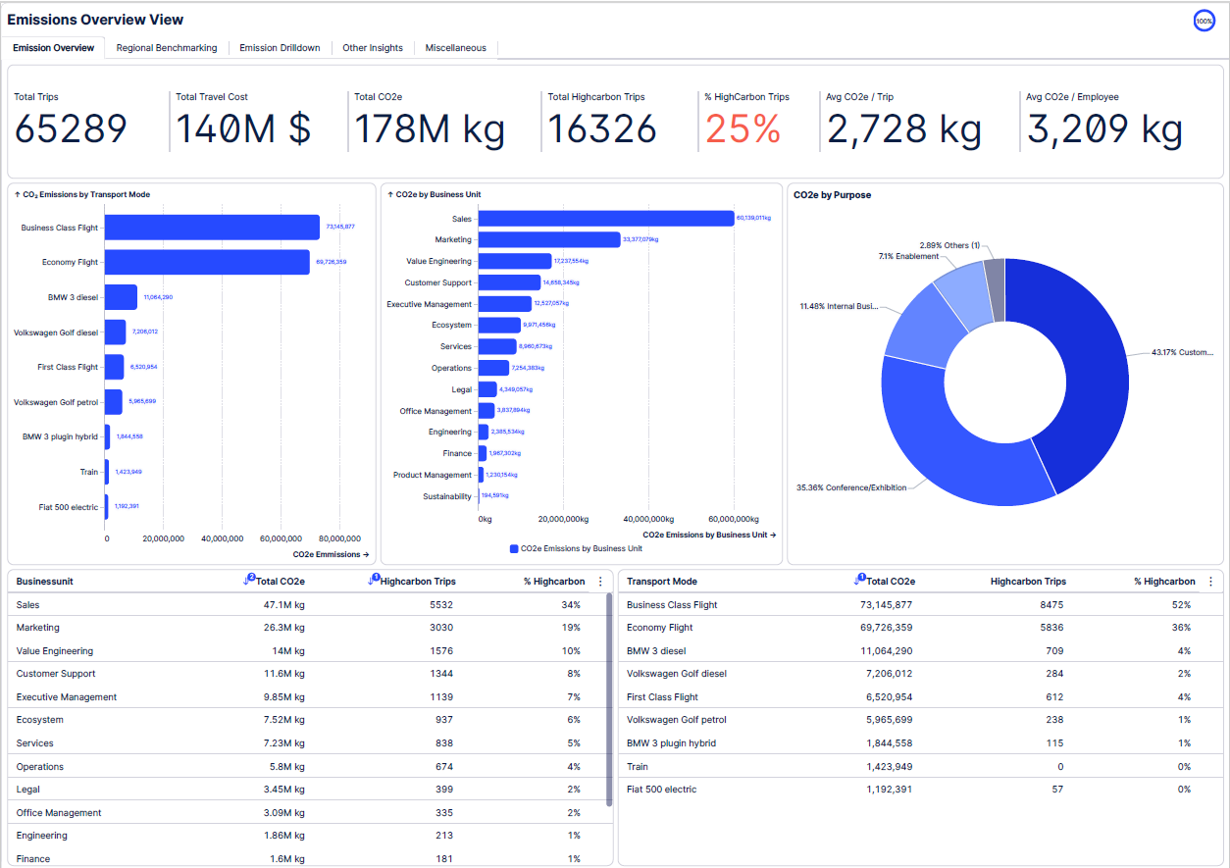
Emission
Overview
Notes:
Link to dashboard: https://academic-celonis-lqh8sk.eu-2.celonis.cloud/package-manager/ui/studio/ui/spaces/27397876-e0f9-4ab1-b5c1-32d48cf58785/packages/c4010fb1-55f1-4799-803e-8af582d5c88d/nodes/40d95d0f-8d0e-4448-9ca3-e67621a91548?activeTabs=1ccae651_9ff1_469e_9d96_3a835a1633a8-view:df200320-c7ee-4687-aacf-2c08791c61a6&share=ecdf4195-a79e-4433-a2d6-e768b21af3a9&bookmark=false

Slide 10
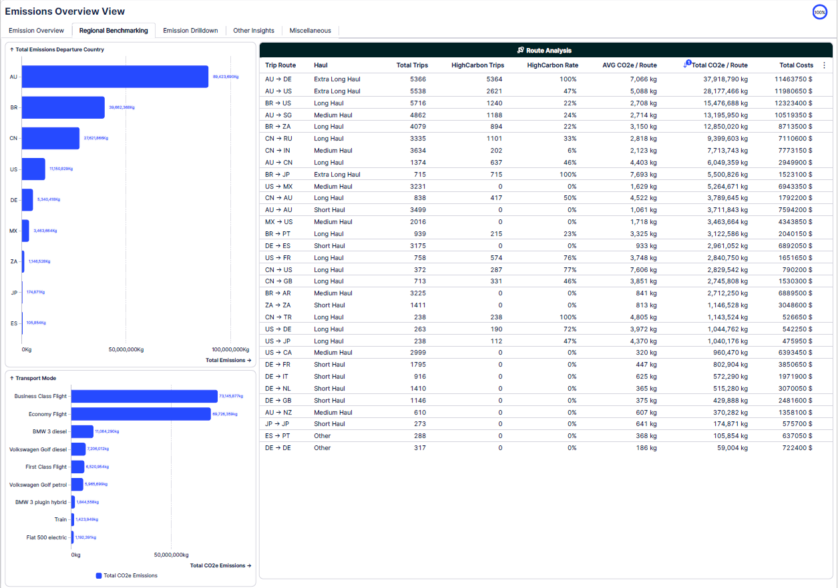
Regional
Benchmarking
Route and Region Analysis
Notes:
Link to dashboard: https://academic-celonis-lqh8sk.eu-2.celonis.cloud/package-manager/ui/studio/ui/spaces/27397876-e0f9-4ab1-b5c1-32d48cf58785/packages/c4010fb1-55f1-4799-803e-8af582d5c88d/nodes/40d95d0f-8d0e-4448-9ca3-e67621a91548?activeTabs=1ccae651_9ff1_469e_9d96_3a835a1633a8-view:df200320-c7ee-4687-aacf-2c08791c61a6&share=ecdf4195-a79e-4433-a2d6-e768b21af3a9&bookmark=false

Slide 11
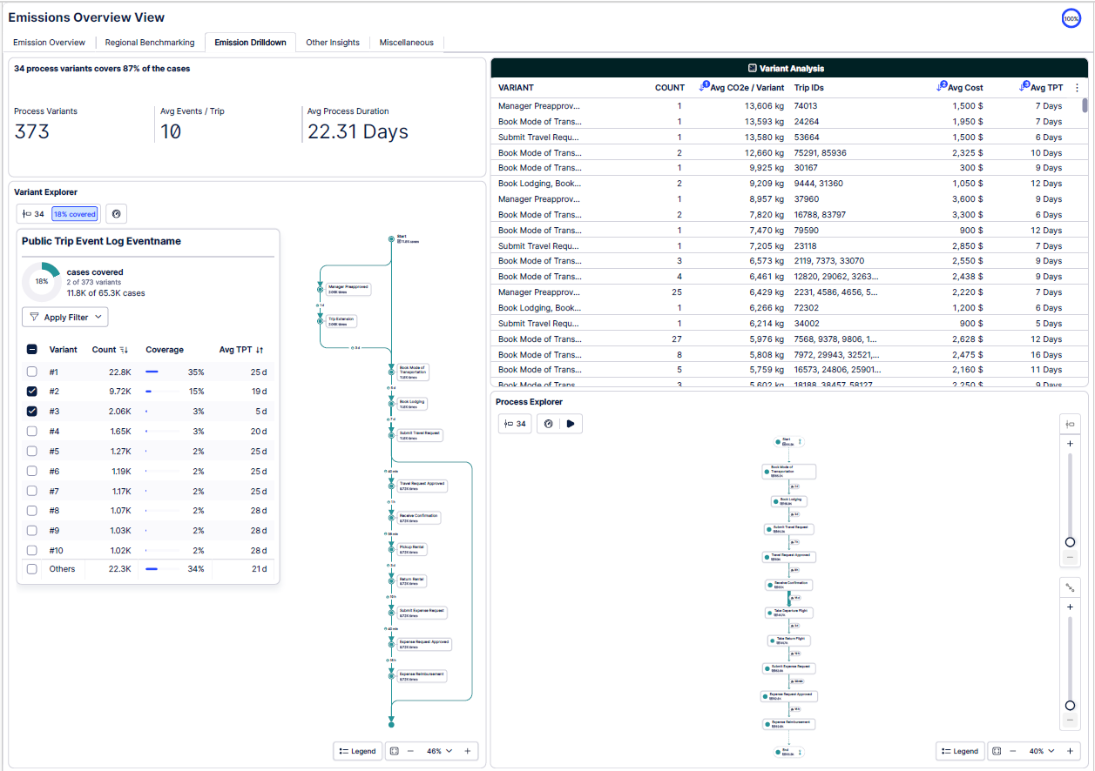
Emission
Drilldown
Variants & Processes
Notes:
Link to dashboard: https://academic-celonis-lqh8sk.eu-2.celonis.cloud/package-manager/ui/studio/ui/spaces/27397876-e0f9-4ab1-b5c1-32d48cf58785/packages/c4010fb1-55f1-4799-803e-8af582d5c88d/nodes/40d95d0f-8d0e-4448-9ca3-e67621a91548?activeTabs=1ccae651_9ff1_469e_9d96_3a835a1633a8-view:df200320-c7ee-4687-aacf-2c08791c61a6&share=ecdf4195-a79e-4433-a2d6-e768b21af3a9&bookmark=false

Slide 12

THANK YOU

